Slide 1
Optimize institution’s student admission process
By Priya Phapale
Student id - 94662

Slide 2
Introduction
Now a days university has a big responsibility to decide which student should get admit and which student should reject.
We all know this decision is hard and time taking as there are many attributes to be considered like good GPA, GRE, TOEFL scores, impressive SOPs, Letter of recommendations, extracurricular, Outstanding Achievements, Projects and Research etc.
As there are millions of profiles process of selection becomes time consuming. To make this process easier we need such a model which will consider all attributes and produce result.

Slide 3
Goal and strategy
Goal - To optimize institution’s student admission process which can be addressed using the decision tree techniques
Data collection and visualize the data- we are using data set which has four attributes- Admit, GRE, GPA, Rank. We need to visualize the data in table format
Apply some statistics on data like sum of each column, mean value etc.
Visualize the data for GRE, GPA attributes in graphical form using Seaborn library.
Train our model using sigmoid function and find accuracy of it.
Then we need to normalize GRE and GPA columns value as they have large values.
Split into features and targets and find prediction accuracy.
Building decision tree model using sklearn module
Prediction of a new data on any model

Slide 5
Decision Tree Technique
Useful and popular technique
Flowchart-like tree structure designed as per human level thinking and widely used for making predictions
A node represents feature or attribute, the branch represents a decision rule, and each leaf node represents the outcome
Decision tree technique is a distribution-free or non-parametric method
It does not depend upon probability distribution assumptions.
Can handle high dimensional data with good accuracy.

Slide 6
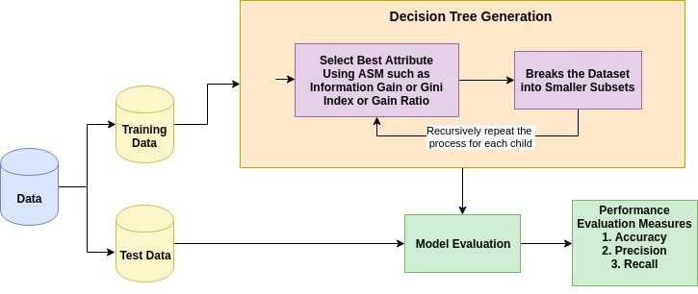
How it works?

Slide 7
Attribute Selection Measures
Attribute selection measure is a heuristic for selecting the splitting criterion that partition data into the best possible manner.
It helps us to determine breakpoints for tuples on a given node
ASM provides a rank to each feature(or attribute) by explaining the given dataset.

Slide 8


Information Gain
Entropy- Measures the impurity of the input set.
Information gain is the decrease in entropy.
Information gain computes the difference between entropy before split and average entropy after split of the dataset based on given attribute values

Slide 9


Gain ratio
Where,
|Dj|/|D| acts as the weight of the jth partition.
v is the number of discrete values in attribute A.

Slide 10
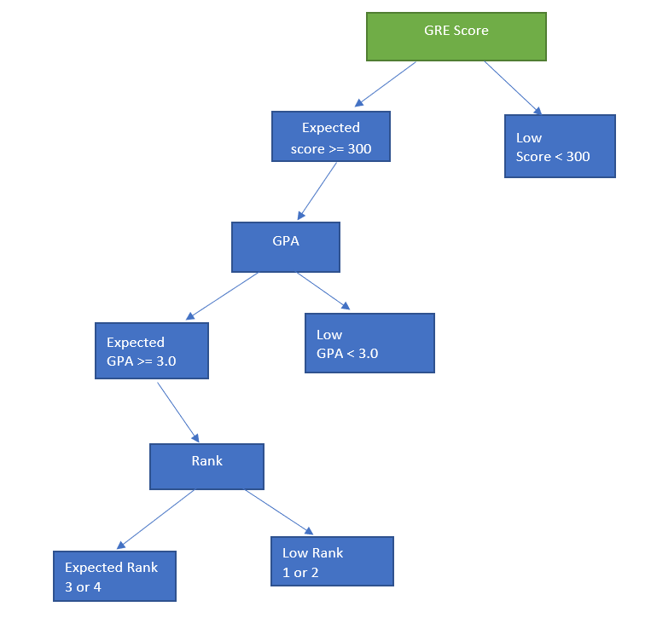
Decision tree for student admission prediction

Slide 11
Thank you..

